Slide 1
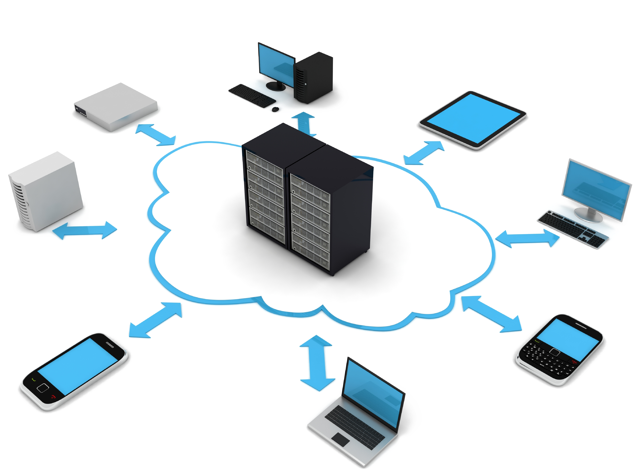
SILECS
Super Infrastructure for Large-scale Experimental Computer Science
F. Desprez, O. Richard
October 2017

Slide 2
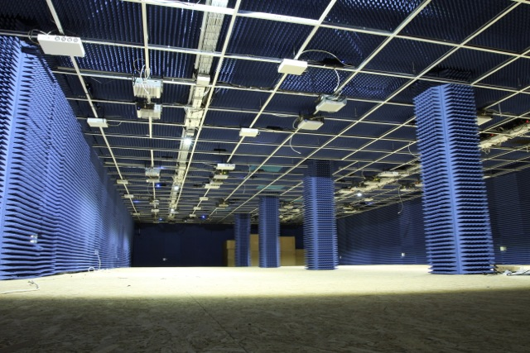
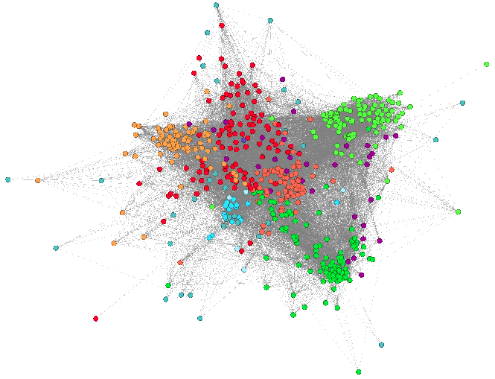
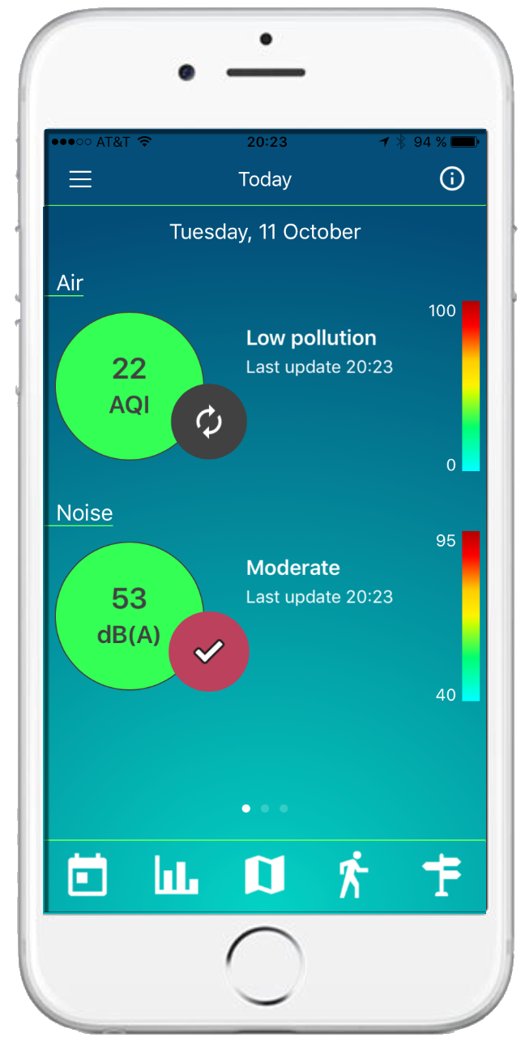
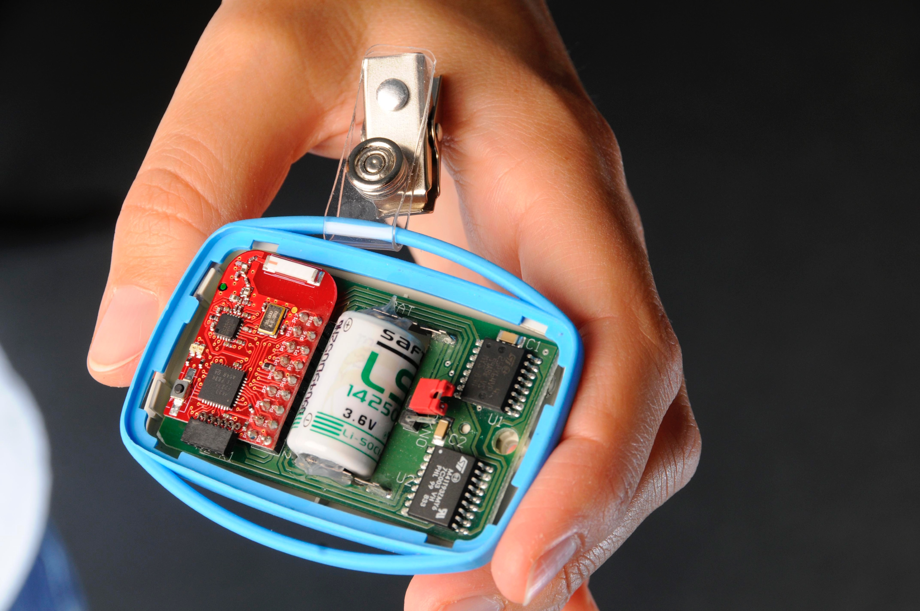
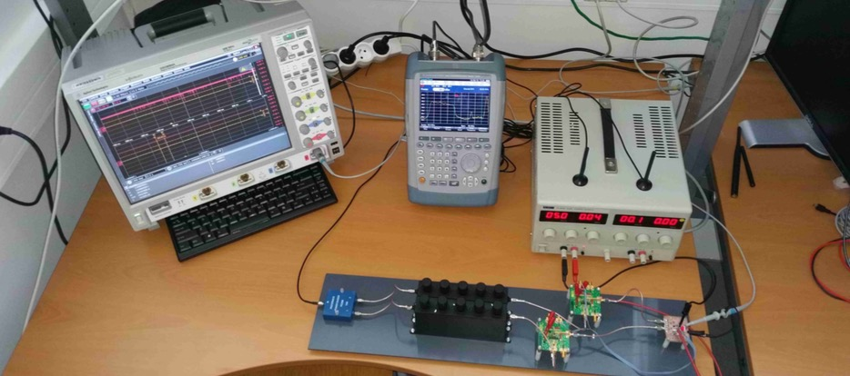
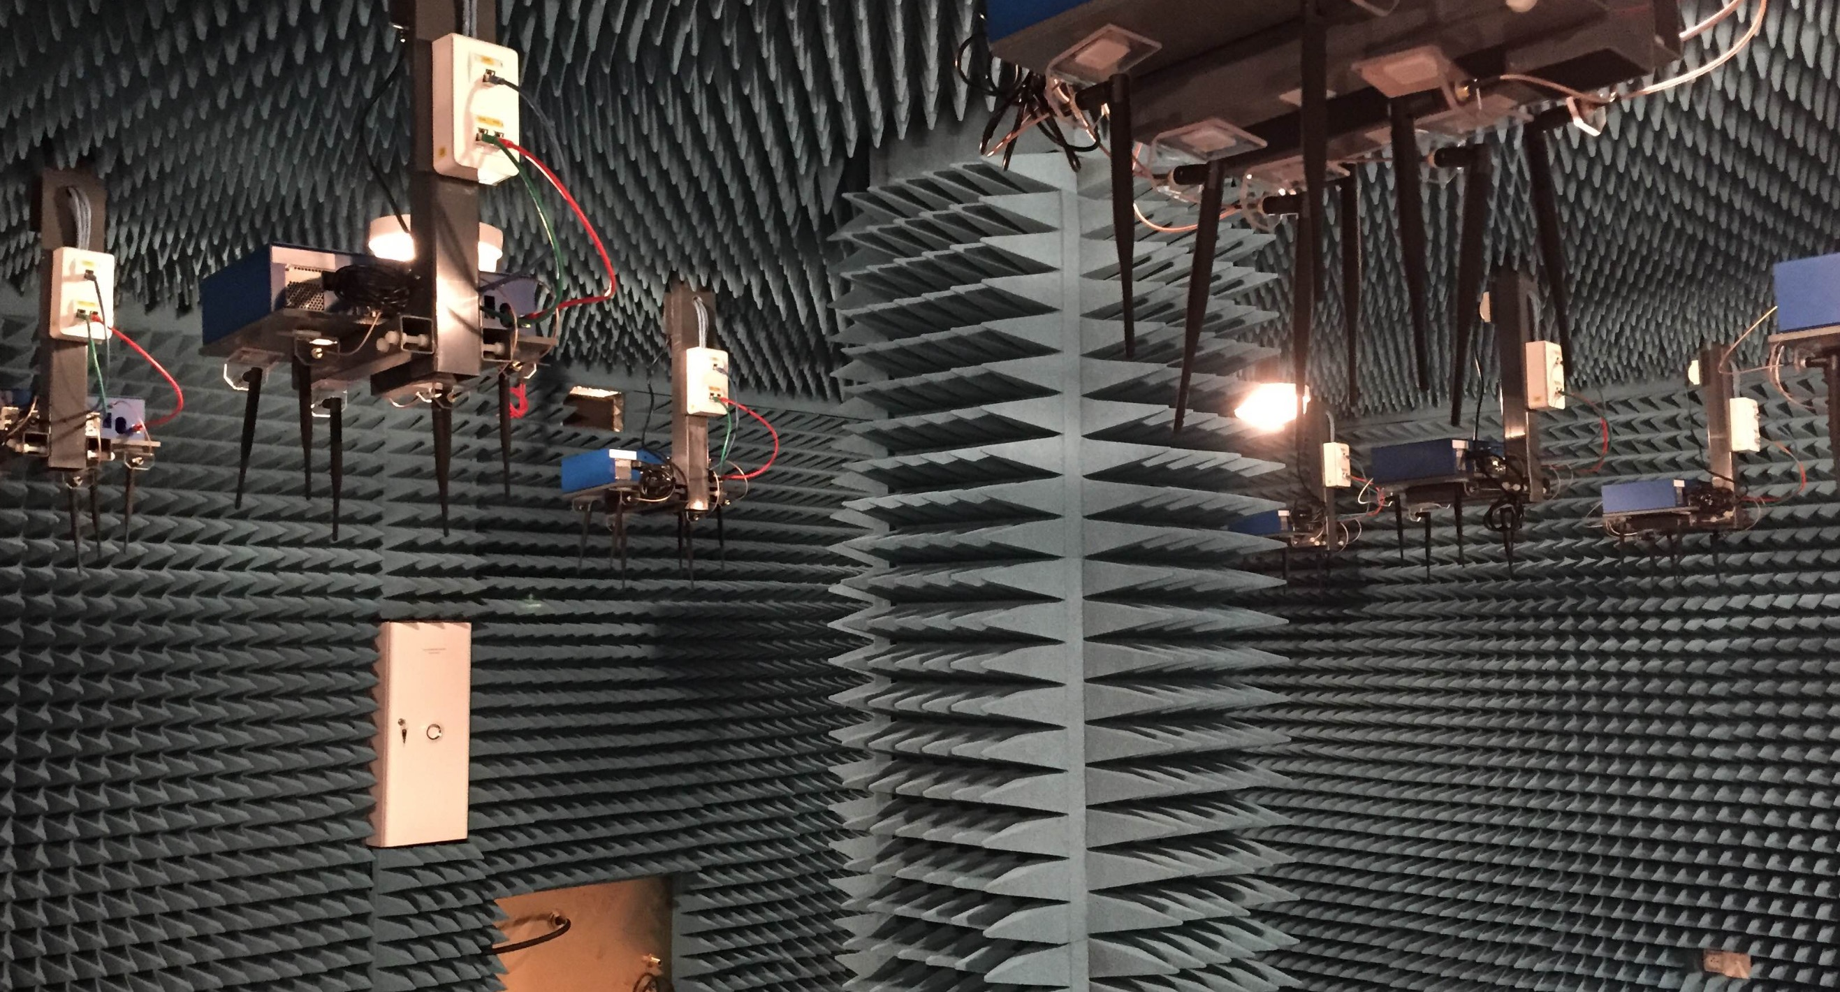
Introduction
Exponential improvement of
Electronics (energy consumption, size, cost)
Capacity of networks (WAN, wireless)
Exponential growth of applications near users
Smartphones, tablets, connected devices, sensors, …
Large number of Cloud facilities to cope with generated data
Many platforms and infrastructures available around the world
Several offers for IaaS, PaaS, and SaaS platforms
Public, private, community, and hybrid clouds
Going toward distributed Clouds (FOG, Edge)
Prediction of 50 billions of connected devices by 2020 (CISCO)
O. Richard - SILECS
Journées SUCCES - Oct. 2017
- <number>
Notes:
Explosion du nombre d’objets connectés grâce notamment aux progrès de l’électronique
Augmentation de la capacité des réseaux
Plein de Clouds –> fog et edge
<number>

Slide 3
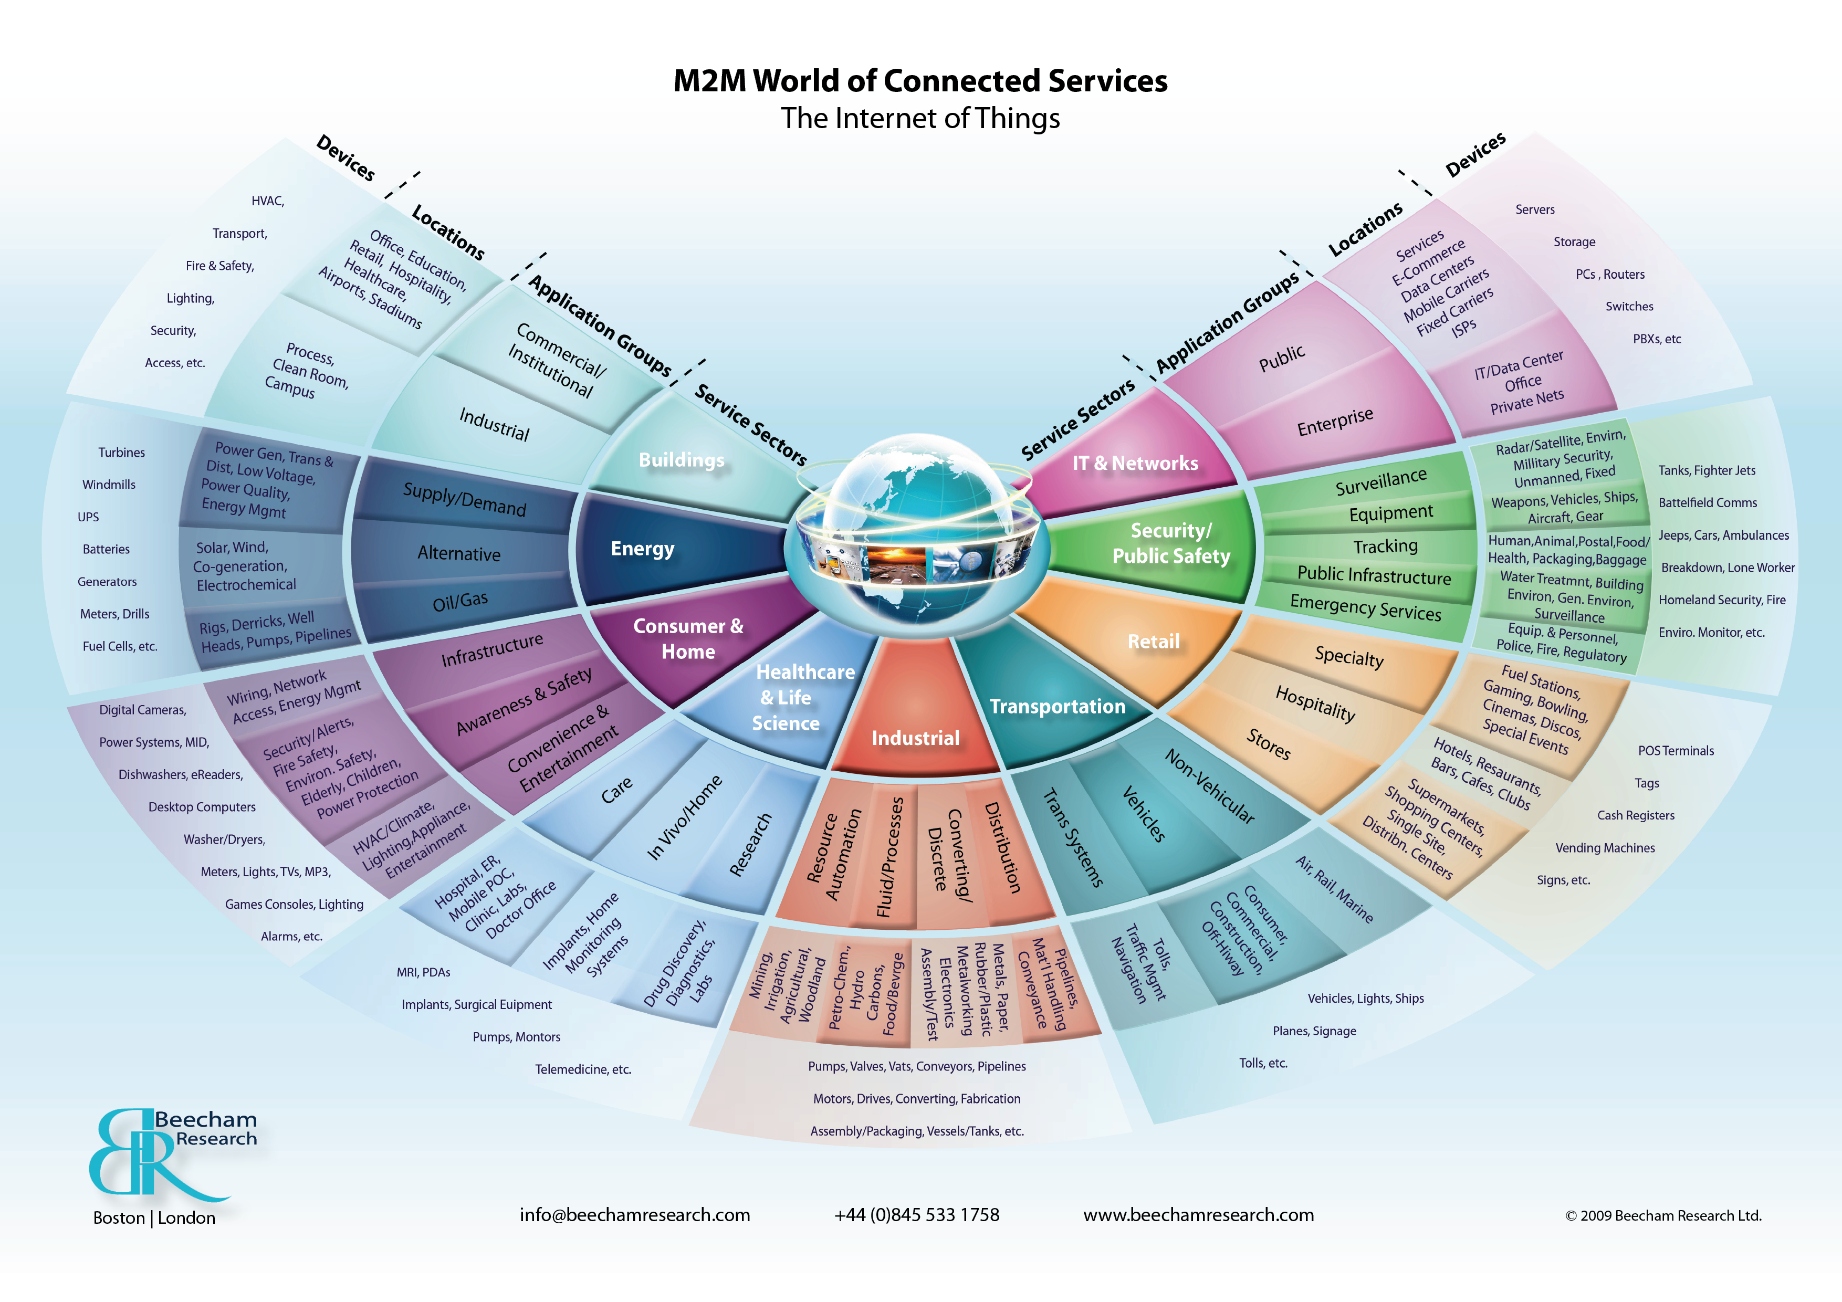
O. Richard - SILECS
Journées SUCCES - Oct. 2017
- <number>
http://www.beechamresearch.com/article.aspx?id=4
Notes:
Un large spectre d’applications de l’IoT => plein de données, plein de problématiques différentes
<number>

Slide 4
Cloud Evolution
Not only mega data centres !
Courtesy to Thierry Coupaye (Orange)
O. Richard - SILECS
Journées SUCCES - Oct. 2017
<number>

Slide 5
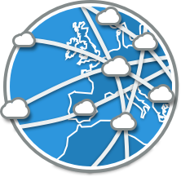
Convergence
Computation
1950/1990 - Mainframes
1975 -Personal
Computers
1999 - Salesforces SaaS Concept
2002 - Virtualised Infrastructure
2010 - Cloud democratisation
1950 - Batchmode
1960 - Interactive
ENIAC 1946
1967 - First virtualisation attempt
1999 - The Grid
2015 Network/Computers Convergence Software Defined XXX
1970 - Terminals (clients/server concepts)
Transistor 1947
2002- Amazon Initial Compute/Storage services
micro processor 1971
2006 - Amazon EC2 (IaaS)
1838 - Telegraph
1995 - Commodity clusters
1957 - satellite
1985 - TCP/IP Adoption
SmartPhones 2007
1973 - Ethernet
1876 - Telephone
1969 - ARPANET
1896 - Radio
Communication
O. Richard - SILECS
Journées SUCCES - Oct. 2017
- <number>

Slide 6
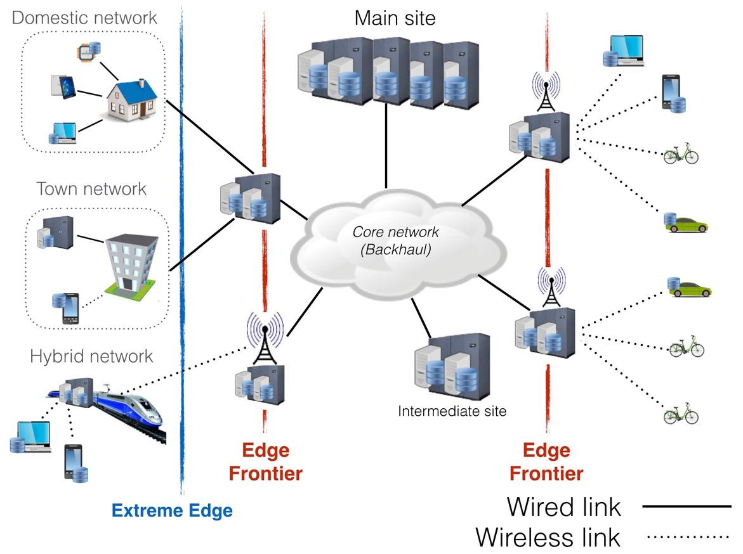
Cloud-IoT Convergence
O. Richard - SILECS
Journées SUCCES - Oct. 2017
- <number>

Slide 7
“Good experiments”
A good experiment should fulfill the following properties
Reproducibility: must give the same result with the same input
Extensibility: must target possible comparisons with other works and extensions (more/other processors, larger data sets, different architectures)
Applicability: must define realistic parameters and must allow for an easy calibration
“Revisability”: when an implementation does not perform as expected, must help to identify the reasons
O. Richard - SILECS
Journées SUCCES - Oct. 2017
- <number>

Slide 8
SILECS: Super Infrastructure for Large-scale Experimental Computer Science
Having a large scale infrastructure to experiment IoT/Edge cloud applications and software stacks
Scaling factor
Exascale platforms
Virtualized, Programmable
FOG and Mobile Edge Computing
Features
Manageability
Agility (SDN, NFV)
Self adaptability
Global orchestration
Complexity
Resources
Energy
Data Flow Management
Data deluge processing
O. Richard - SILECS
Journées SUCCES - Oct. 2017
- <number>

Slide 9
SILECS: based upon two infrastructures
FIT
Proving Internet players access to a variety of fixed and mobile technologies and services, thus accelerating the design of advanced technologies for the Future Internet
4 key technologies and a single control point: IoT-Lab (connected objects & sensors, mobility), CorteXlab (Cognitive Radio), wireless (anechoic chamber), Network Operations Center (including a PLE access), Advanced Cloud technology including OpenStack
9 sites (Paris (2), Evry, Rocquencourt, Lille, Strasbourg, Lyon, Grenoble, Sophia Antipolis)
Grid’5000
A scientific instrument for experimental research on large future infrastructures: Clouds, datacenters, HPC exascale, Big Data infrastructures, networks, etc.
10 sites, service nodes, > 8000 cores, with a large variety of network connectivity and storage access, dedicated interconnection network granted and managed by RENATER gathered around a GIS (CNRS, CEA, Inria, CPU, RENATER, Institut Mines-Telecom, CDEFI)
Software stacks dedicated to experimentation
Monitoring tools, resource reservation, data collection and storage
O. Richard - SILECS
Journées SUCCES - Oct. 2017
- <number>

Slide 10
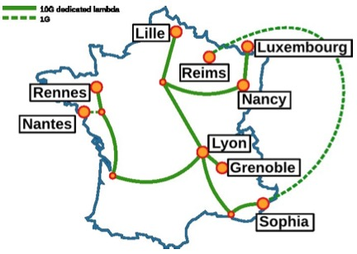
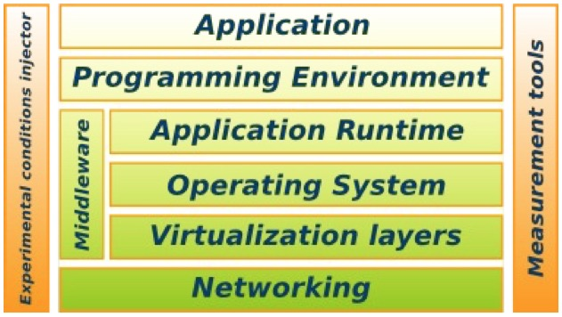
Grid’5000
Testbed for research on distributed systems
Born from the observation that we need a better and larger testbed
HPC, Grids, P2P, and nowCloud computing and BigData systems
A complete access to the nodes’ hardware in an exclusive mode (from one node to the whole infrastructure)
Dedicated network (RENATER)
Reconfigurable: nodes with Kadeploy and network with KaVLAN
Current status
10 sites, 29 clusters, 1060 nodes, 10474 cores
Diverse technologies/resources (Intel, AMD, Myrinet, Infiniband, two GPU clusters, energy probes)
Some Experiments examples
In Situ analytics
Big Data Management
HPC Programming approaches
Network modeling and simulation
Energy consumption evaluation
Batch scheduler optimization
Large virtual machines deployments
O. Richard - SILECS
Journées SUCCES - Oct. 2017
- <number>

Slide 11
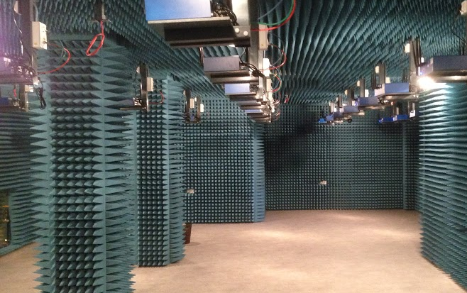
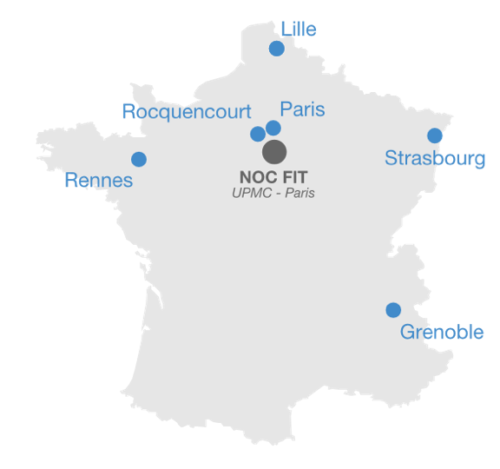
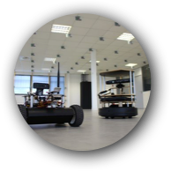
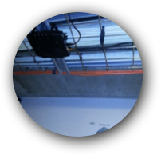
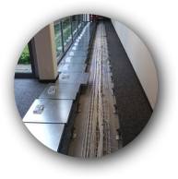
FIT Infrastructure
FIT-Wireless: WiFi mesh testbed
(DIANA)
FIT-CorteXlab: Cognitive Radio Testbed
40 Software Defined Radio Nodes
(SOCRATE)
Lyon
Sophia
FIT-IoT-LAB
2700 wireless sensor nodes spread across six different sites in France
Nodes are either fixed or mobile and can be allocated in various topologies throughout all sites.
O. Richard - SILECS
Journées SUCCES - Oct. 2017
- <number>

Slide 12
SILECS Design Objectives
Deploy a large set of digital resources from sensors to data centers
Open, remotely accessible, virtualized infrastructure
Provide rich, diverse and advanced tools: test, measurement, benchmarking, reproducibility, data repository, …
Typically a « mid-scale » infrastructure
Mobilize the scientific community in the domain of digital sciences
Articulate the French and European efforts in this domain
International attractivity and visibility (unique today at the international level)
Several challenges
Heterogeneity of the resulting infrastructures
Different communities and different software stacks
Keep reproducibility at its highest level
Keep the infrastructure up-to-date
Connect the infrastructure to other platforms in Europe (and elsewhere)
O. Richard - SILECS
Journées SUCCES - Oct. 2017
- <number>

Slide 13
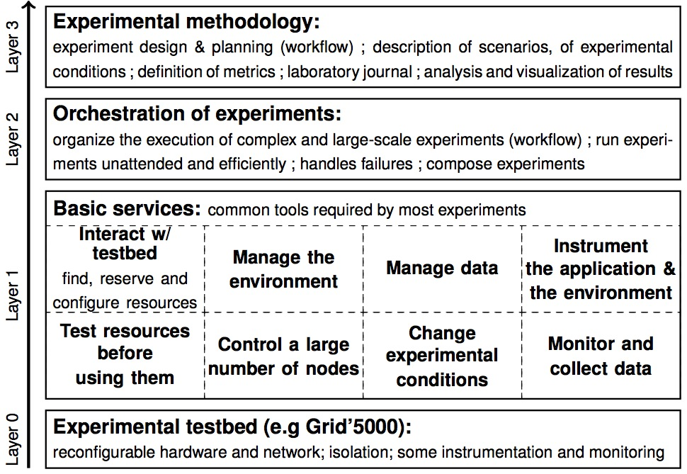
The GRAIL
O. Richard - SILECS
Journées SUCCES - Oct. 2017
- <number>

Slide 14
Conclusions
New infrastructure based on two existing instruments (FIT and Grid’5000)
Keep the aim of previous platforms (their core scientific issues addressed)
IoT, wireless networks, future Internet for FIT
HPC, Big Data, Clouds, Virtualization, … for Grid’5000
Address new challenges
IoT and Clouds
New generation Cloud platforms and software stacks (Edge, FOG)
Data streaming applications
Locality aware resource management
…
Submitted to ESFRI in August
New TGIR ?
O. Richard - SILECS
Journées SUCCES - Oct. 2017
- <number>

Slide 15
Thanks Any questions ?

